Slide 1


SUSTRACCIÓN DEL RUIDO MAGNÉTICO INDUCIDO POR LOS CAMBIOS DE TEMPERATURA DE UN IMÁN DE NEODIMIO EN ÓRBITA LEO
AUTHOR: Pablo Cárdenas Fernández
Notes:
Success in space missions is the pinacle of every single aerospace engineer. I’m Pablo Cardenas and this is the final degree thesis on the “titulo”

Slide 2

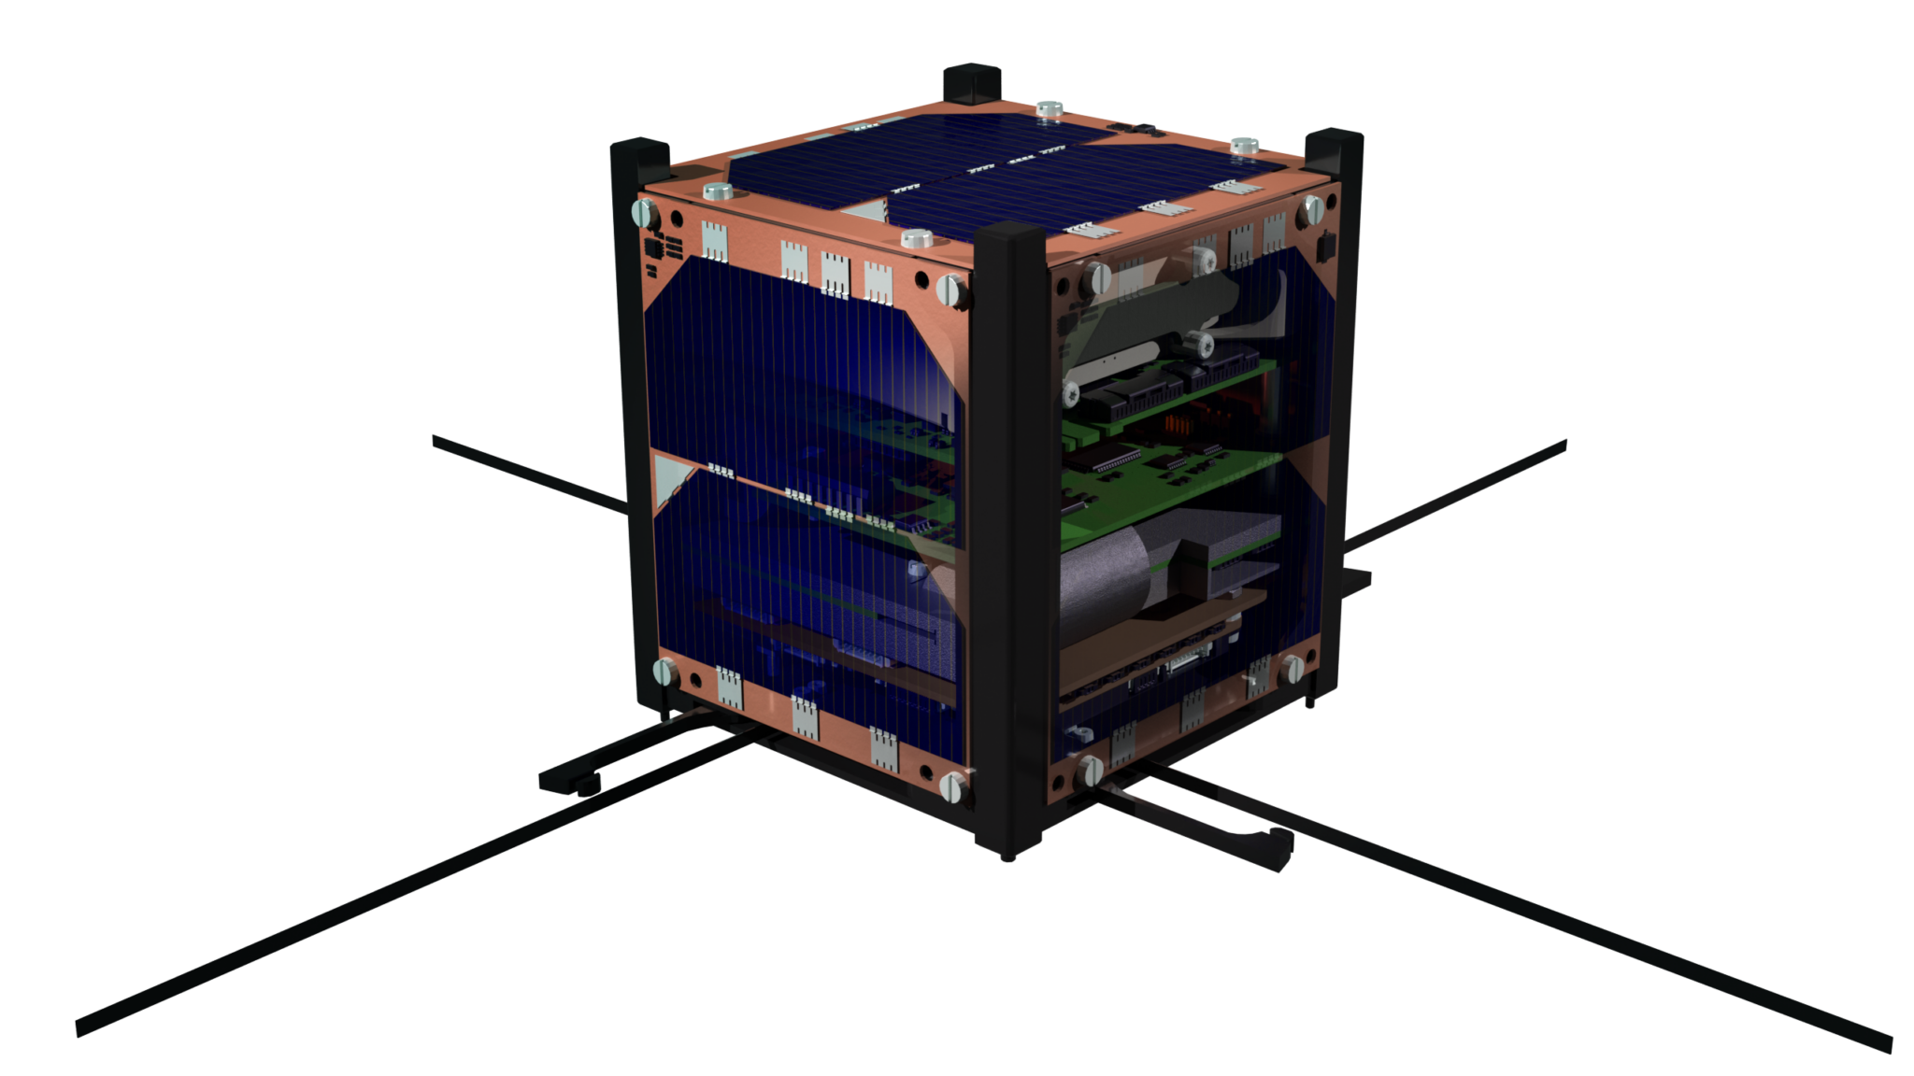

UCAnFly
Notes:
UCF
-Educational project by UCA students not only engineers.
Aim to design, assemble, test and fly a 1 U cubesat
Colaboration with ESA under the Fly your satellite! Program

Slide 3
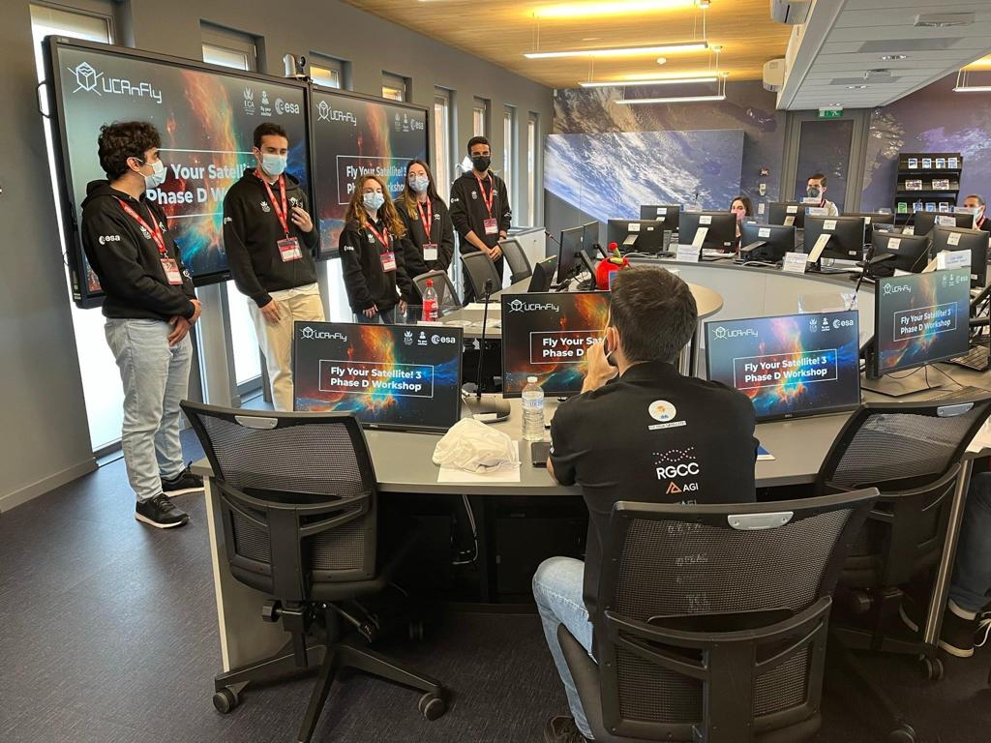
UCAnFly
Notes:
UCF
-Educational project by UCA students not only engineers.
Aim to design, assemble, test and fly a 1 U cubesat
Colaboration with ESA under the Fly your satellite! Program

Slide 4
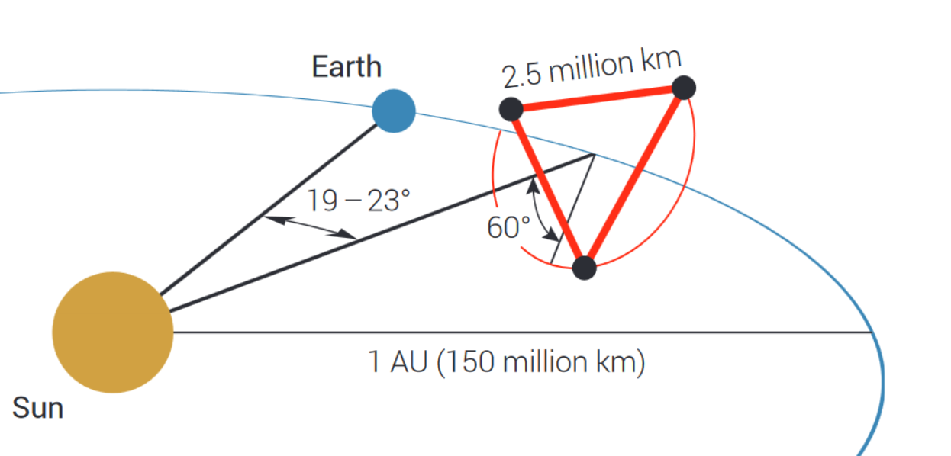
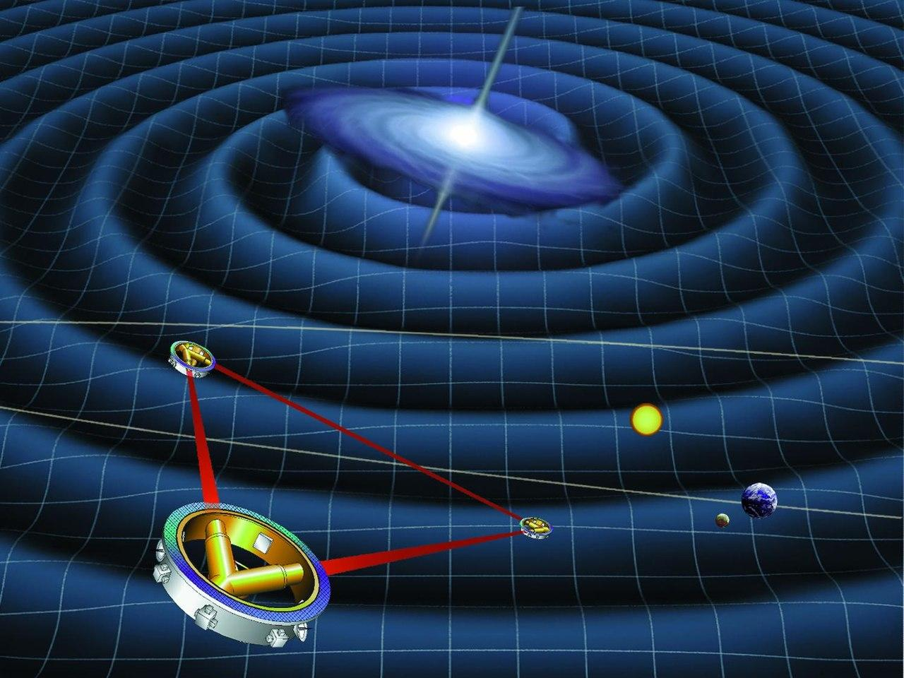
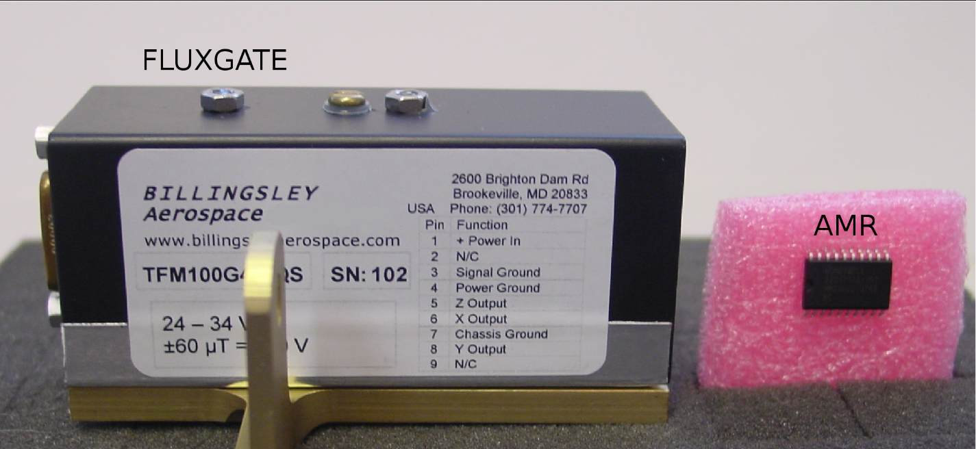
LISA Mission
Notes:
LISA is an space born gravitational wave detector whose functionallity is founded in laser interferometry. In each of the spacecraft that form a triangle constalation a test mass shall remain in quasistatic freefalling state. In order to counteract magnetic disturbances, heavy, power consuming and expensive flucgate sensors are used. One of the goals of UCF is hte characterisation of AMR sensors for their use in missions like LISA.

Slide 5
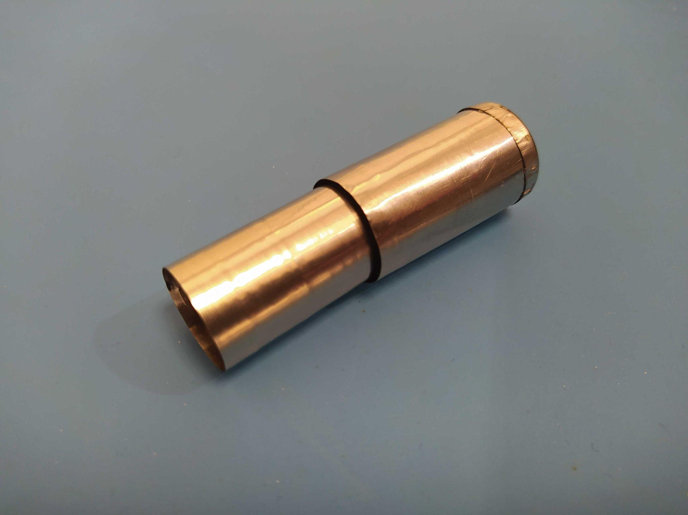

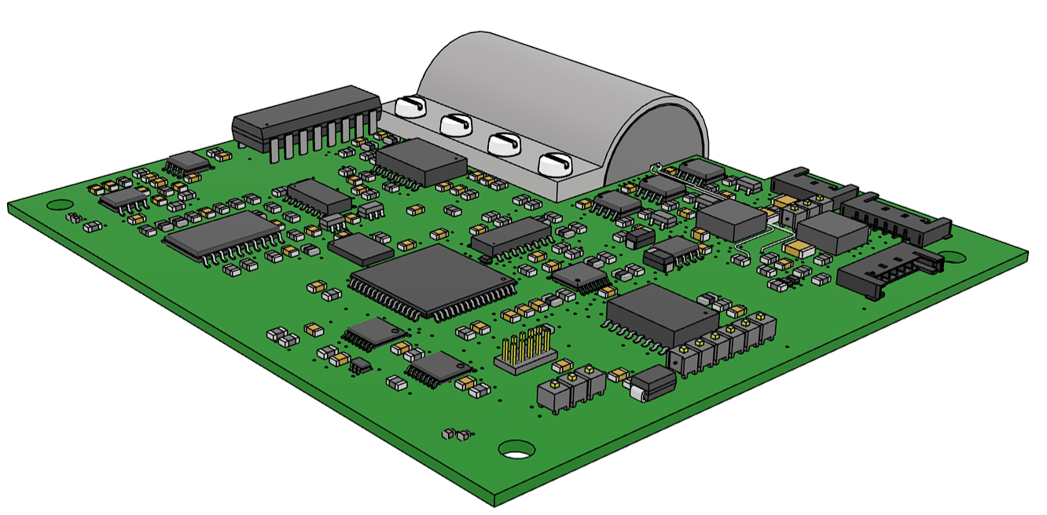

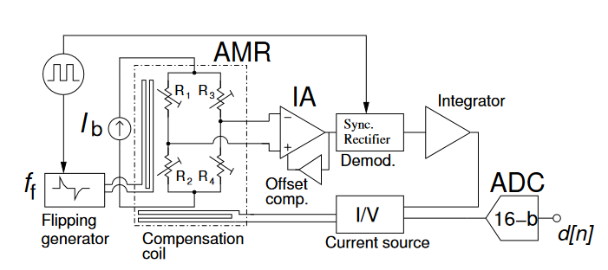
MELISA-II
Magnetic shielding
X
Z
Y
Noise reduction electronic system
AMR sensors

Slide 6
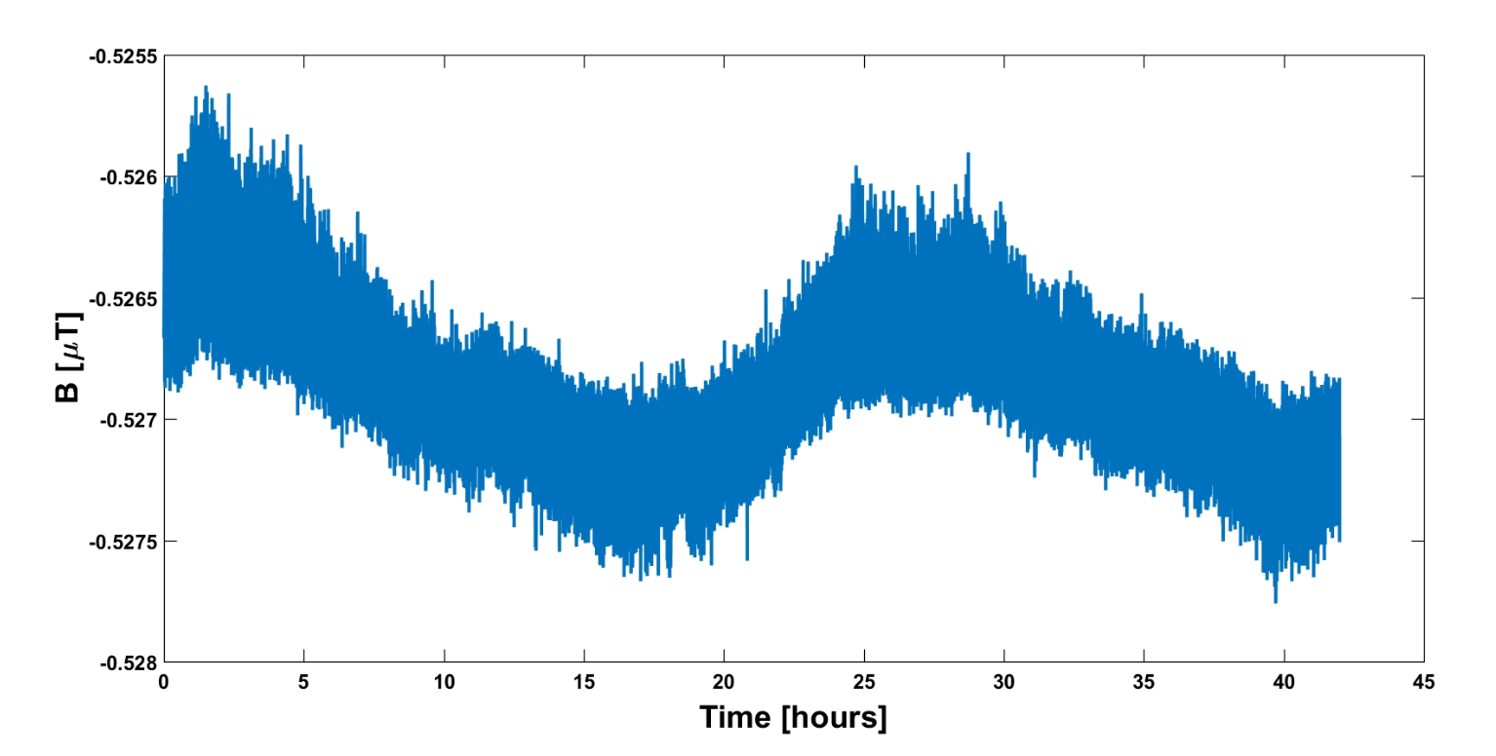
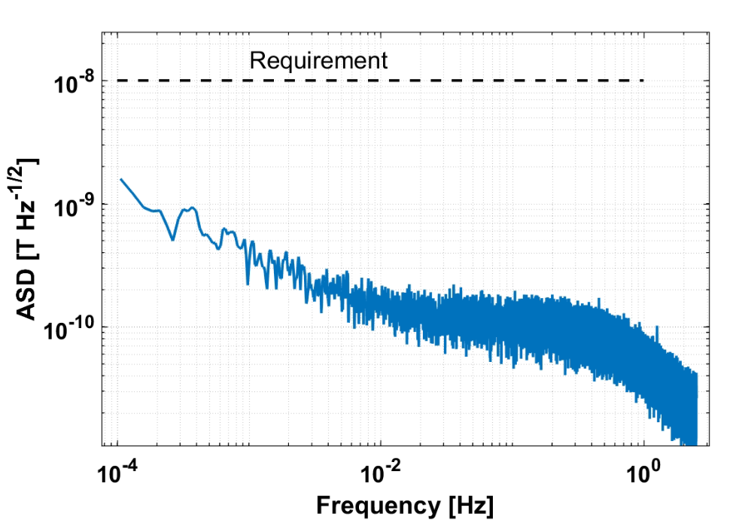

Mission Requirement

Slide 7
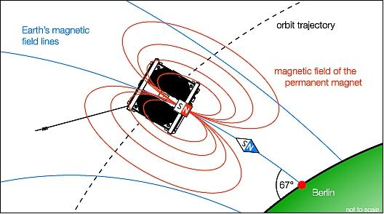
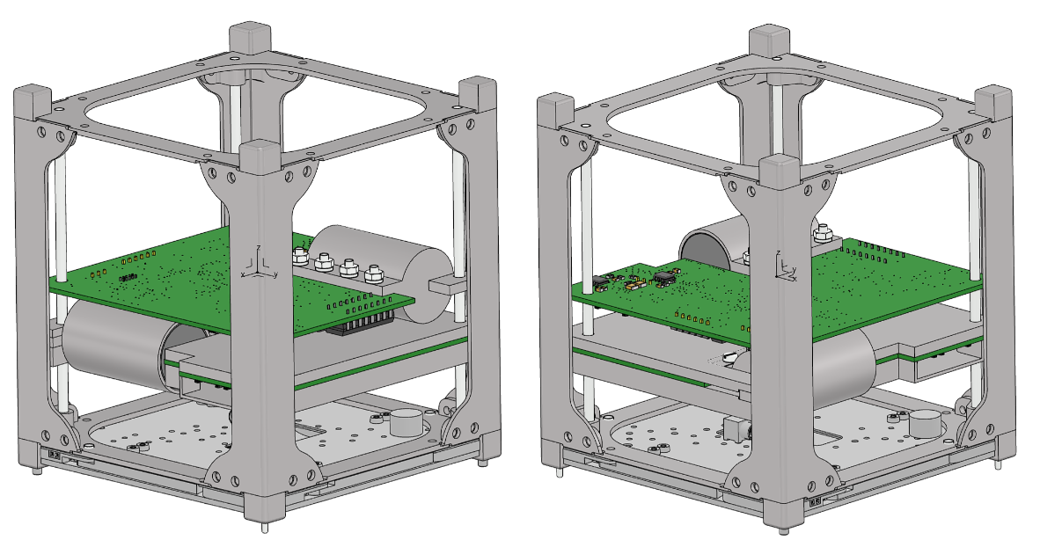
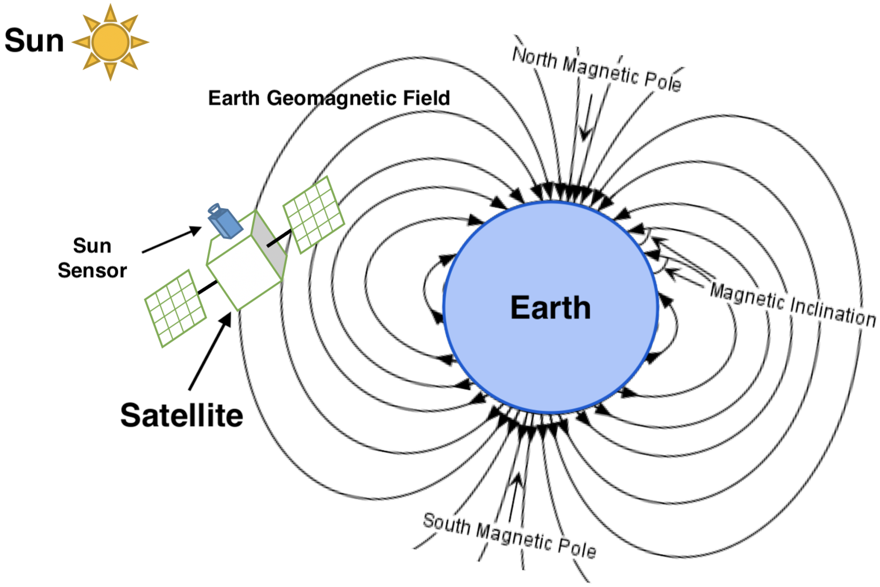
The problem
Permanent magnet

Slide 8
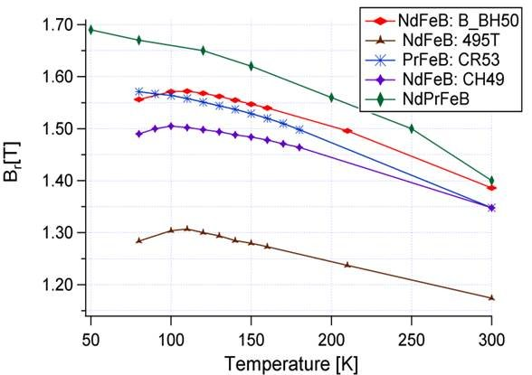
The problem
Permanent magnet

Slide 9
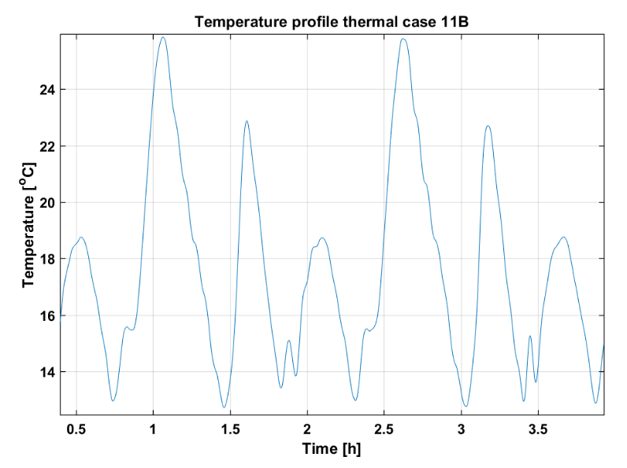
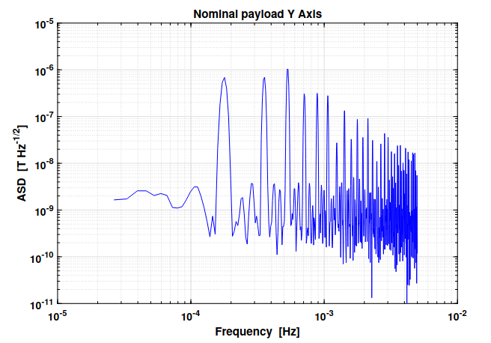
The problem

Slide 10
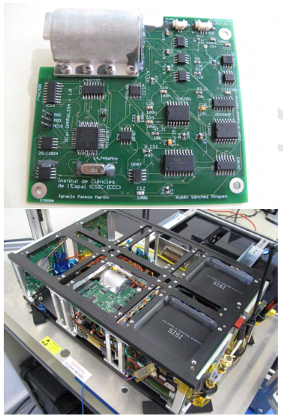
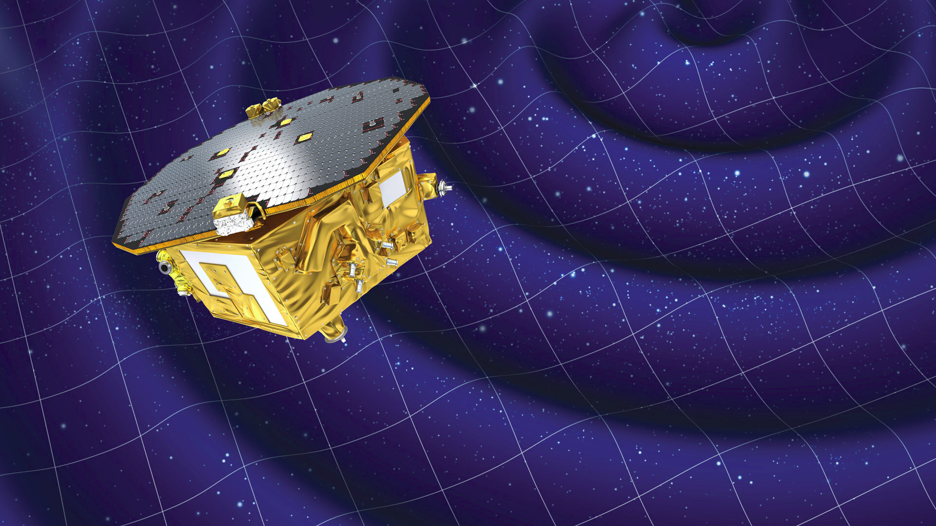
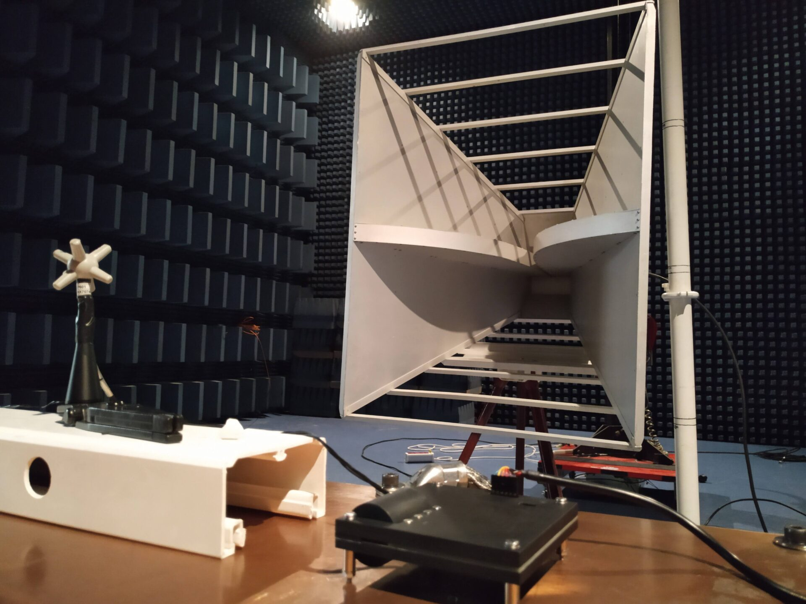

Literature

Slide 11
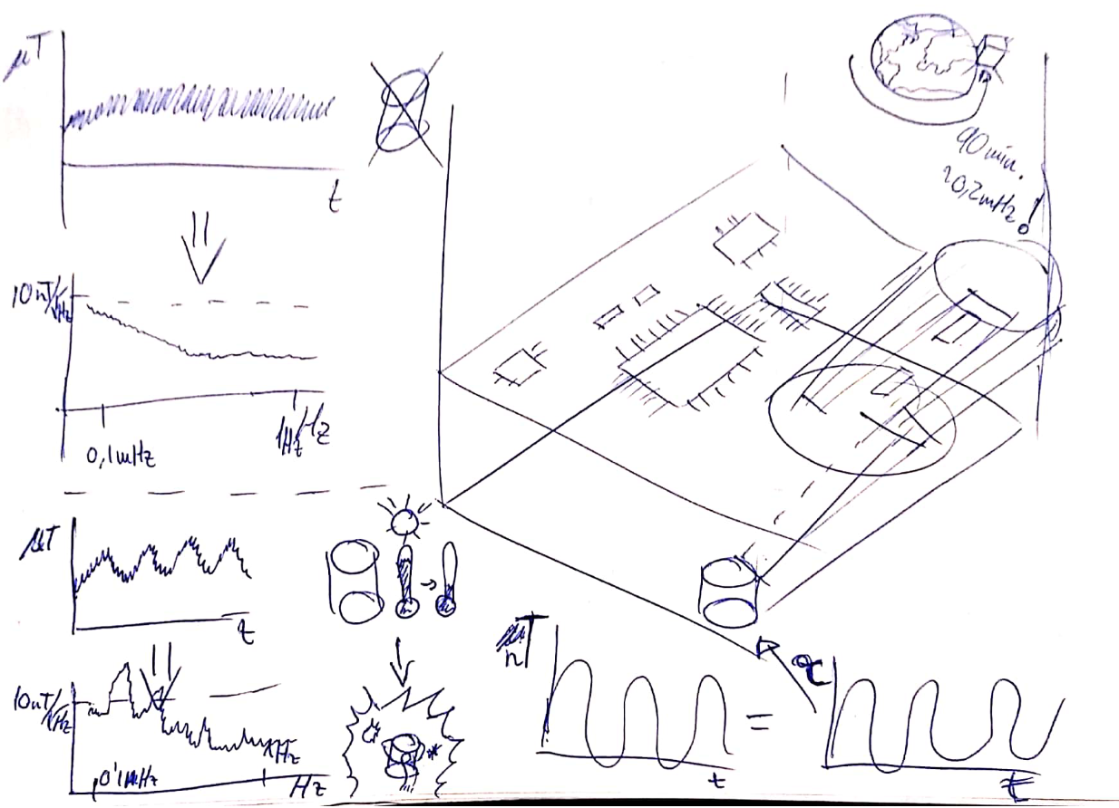
Graphic definition

Slide 12
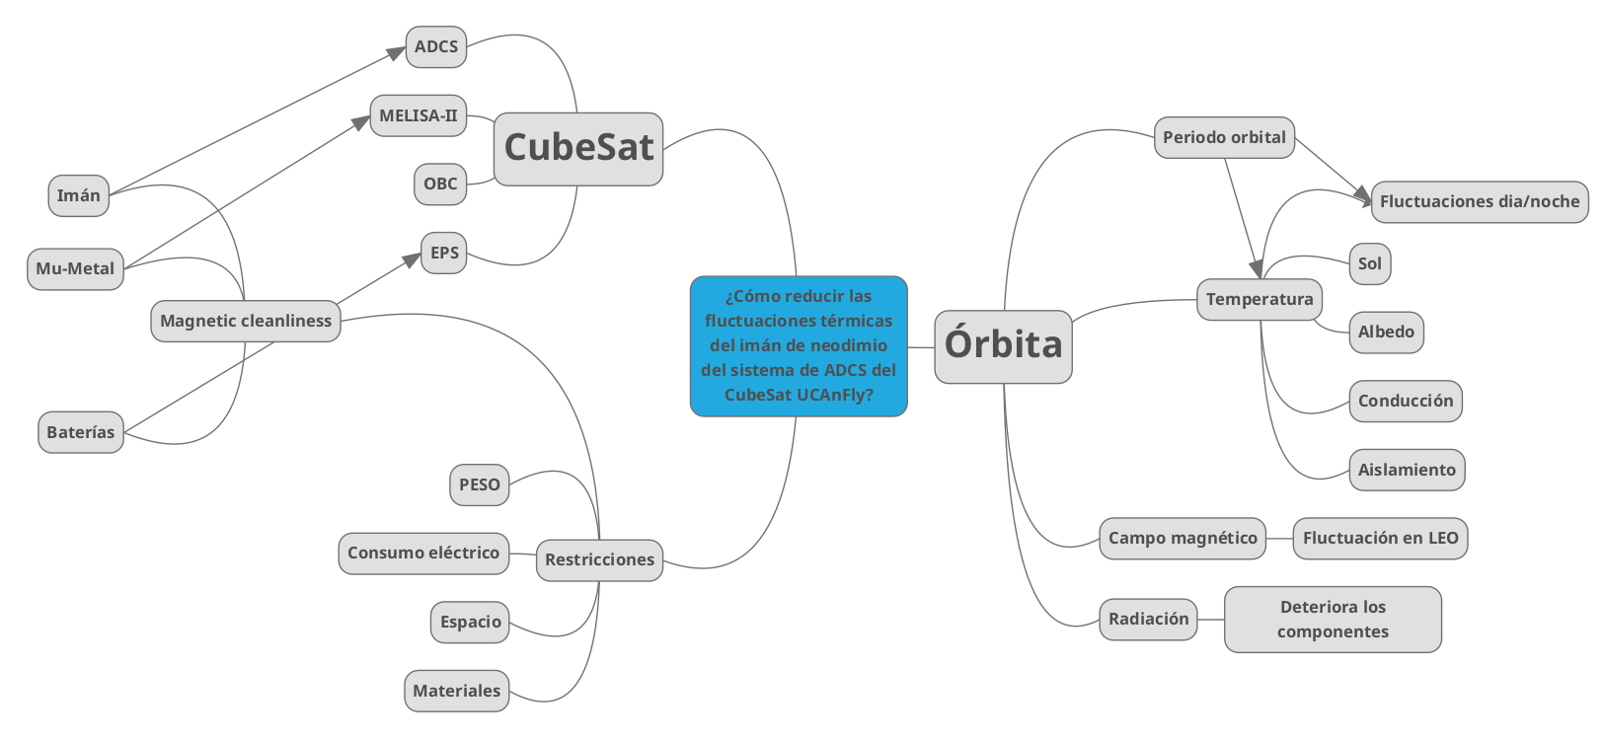
Graphic definition

Slide 13
¿Cómo reducir las fluctuaciones térmicas del imán permanente del sistema de control de actitud durante la misión UCAnFly?

Slide 14
¿Cómo reducir las fluctuaciones magnéticas medidas por MELISA-II provocadas por los cambios de temperatura del imán de neodimio del sistema de ADCS del nanosatélite UCAnFly?
¿Cómo reducir las fluctuaciones térmicas del imán permanente del sistema de control de actitud durante la misión UCAnFly?

